Slide 1
CS 174A – Fall 2019 Introduction to Computer Graphics
Dr. Asish Law
TAs: Jonathan Mitchell, Yunqi Guo

Slide 2
Instructor & TAs
Name | Asish Law | Jonathan Mitchell | Yunqi Guo
Role | Instructor | TA | TA
Email | alaw@cs.ucla.edu | jcmitchell@ucla.edu | guoyunqi@gmail.com
Phone | 626.379.3377 | None | None
Class Location | Kinsey Pavilion 1220B | Royce 362 | Dodd 161
Class Hours | TR 4:00 - 5:50 PM | F 10:00 - 11:50 AM | F Noon - 1:50 PM
Office Location | BH 3531A | BH 9432 | E-VI 396
Office Hours | TR 3:30 - 4:00 PM TR 6:00 - 6:30 PM | R 10 AM - Noon | T 9 - 11 AM

Slide 3
Contact Protocol
We expect you to use the course forum (Piazza)
Good for questions and answers
Dissemination of information, assignments, etc.
Try to keep email for class related personal matters
If you ask about assignments, etc. we will likely redirect you to forum

Slide 4


Sign up at the class site on Piazza:
Let us know your Github account name:
http://piazza.com/ucla/fall2019/cs174a
https://forms.gle/6H2Gef41QJ7ykwyM9

Slide 5
Purpose of Class
Learn basic computer graphics and interaction
Opportunity to use all of your CS skills
Help each other, learn how to work in a team
HAVE FUN!
More detail in syllabus

Slide 6
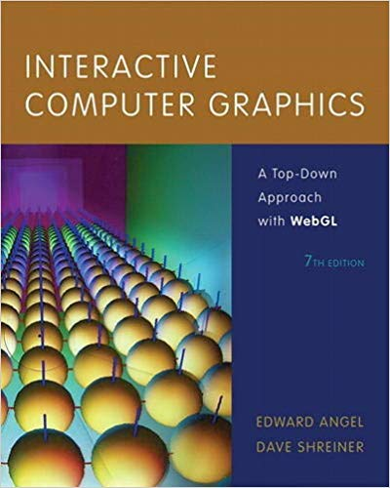
Textbook (Optional)
Interactive Computer Graphics – A Top-Down Approach with WebGL
E-Text only
8th Edition, Angel & Shreiner
ISBN-13: 978-0135258262

Slide 7
Textbook
Textbooks are expensive
Ask on Piazza
Only loosely going to follow this book
Our methodology will diverge quickly
Otherwise this class will mostly follow the usual progression
Many lecture slides have stood the test of time
Some we’ll skip to make room for hands-on demos

Slide 8
Course Administration
Five project assignments
Last one is an open ended group project
Others are to build skills for that one
Grading breakdown (1000 pts):
4 projects (0+50+50+50): 150 pts
Team project: 600 pts
Midterm: 100 pts
Final: 150 pts

Slide 9
Course Administration (contd.)
More Points
Class participation (50 pts)
Interaction with classmates on Piazza (50 pts)
Super impressive final project (50 pts)
Bonus questions on midterm and final exams (50 pts)

Slide 10
Course Administration (contd.)
Curving final grades up or down is not ruled out, if needed to move the distribution so that grades are not too uniform or too low
Besides that, final grades will be awarded as follows:
D-: 500+, D: 550+, D+: 600+, C-: 650+, C: 700+, C+: 750+, B-: 800+, B: 850+, B+: 900+, A-: 950+, A: 1000+, A+: 1100+

Slide 11
Programming Assignments
JavaScript, HTML/CSS, Git are used in this class
If you don’t know these, you will by the end
You’ll even see TAs use them on the screen
Learn to use debuggers (we will not debug for you)

Slide 12
Programming Assignments
Production software off limits - let’s make our own
Libraries - only our small helper code is permitted for most assignments
For team project, outside code won't count towards grade or impressiveness

Slide 13
Team Project (600 points)
Team sizes 3-4
Expectations scale with size
Instructor grading: 200 pts
TA grading: 200 pts
Team grading: 100 pts
Class grading: 100 pts

Slide 14
Team Project
You get to make something!
Show it to your mom
Be proud of it
Put it on your resume
But it was a team effort?
So far that’s been the effective part!
Link to examples from earlier quarters

Slide 15
Individual Project Examples
Done by one person
Done using only:
Plain JavaScript
Low level math
Pixel operations
Some 2D image files
An understanding of 3D techniques

Slide 16
TA Sections
Primarily to discuss JavaScript, Github, project, etc.
Occasionally for more detail (linear algebra)
Deeper dives into specific topics from class
Q&A, homework help

Slide 17
Mathematics of Computer Graphics
Linear (vector/matrix) algebra
Coordinate systems
Geometry
Points, lines, planes
Affine transformations
Projection transformations
More geometry
Curves, surfaces

Slide 18
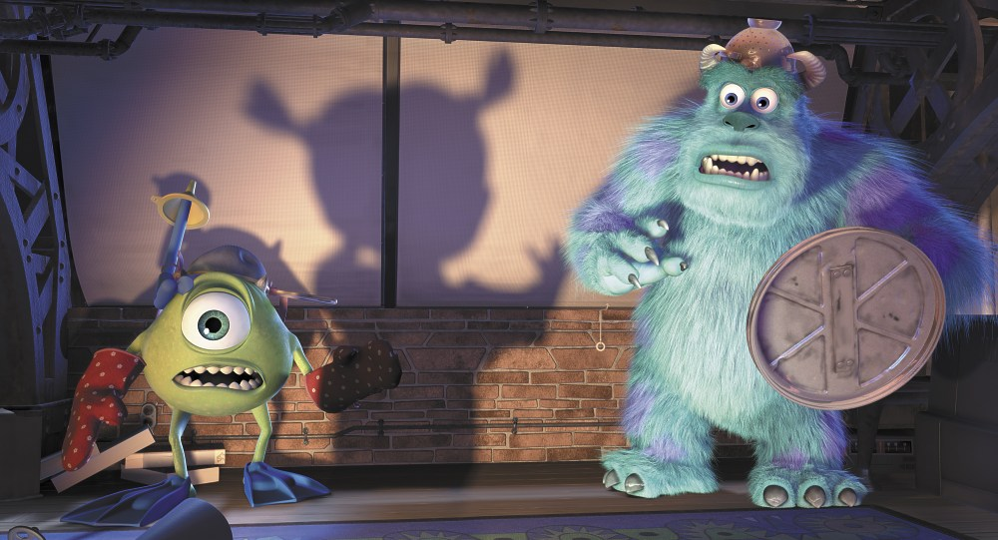
Typical Comments From Prior 174A Course Offerings
Lots of math!
A lot of material
Fast pace
A lot of programming
Challenging final exam

Slide 19
Remember:
Come to class
Manage your course load
Do individual work
Start assignments early
Get help early (on Piazza and in TA sessions)

Slide 20
Remember
If you:
Do the Assignments
Take the Exams
Complete the Term Project
…you should be able to do just fine
Extra stuff is for those of you who
Want to challenge yourself (or show off)
Have some extra fun
Something cool to show during interviews…

Slide 21
Detailed Class Schedule
Week # | Date | Topics | Projects (due on Sundays)
Week 1 | 09/26/19 | Class / project overview, state of graphics field, graphics history, graphics program anatomy
Week 2 | 10/01/19 | Linear Algebra Review, Vector math
 | 10/03/19 | Vertex Arrays, Indexing, Polygons, Interpolation | A1: Set up and use Chrome Developer Tools (due 10/6)
Week 3 | 10/08/19 | Flat vs Smooth Shading
 | 10/10/19 | Matrix transformations, Hierarchies, Viewing
Week 4 | 10/15/19 | Matrix transformation order
 | 10/17/19 | Projections, View Volumes, Smooth Motion in Scenes Shaders, Interpolation, Lighting | A2: Tilting Boxes (due 10/20)

Slide 22
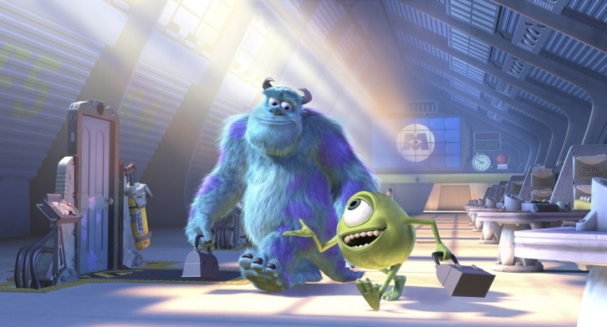
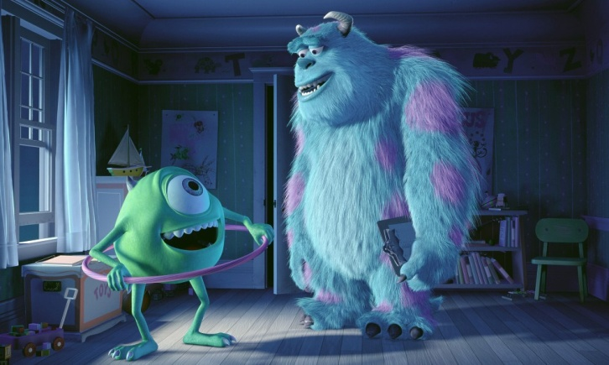
Computer Graphics
The Art and Science of creating imagery by computer
Art
Mathematics
Physics
Vision
Engineering
Optics
Artificial Intelligence
Biomechanics
Notes:
Physics: Natural phenomena, wave theory
Mechanics: fluid mechanics, articulated body mechanics
Optics: camera and lens models
Biomechanics: human motion
AI: human behaviors, learning of motor tasks
Engineering: Control theory, robotics

Slide 23
Applications of CG
Entertainment
Films
Computer games
Virtual reality
Visualization
Scientific visualization
Medical visualization
Flight simulation
Architecture
Education, etc.

Slide 24
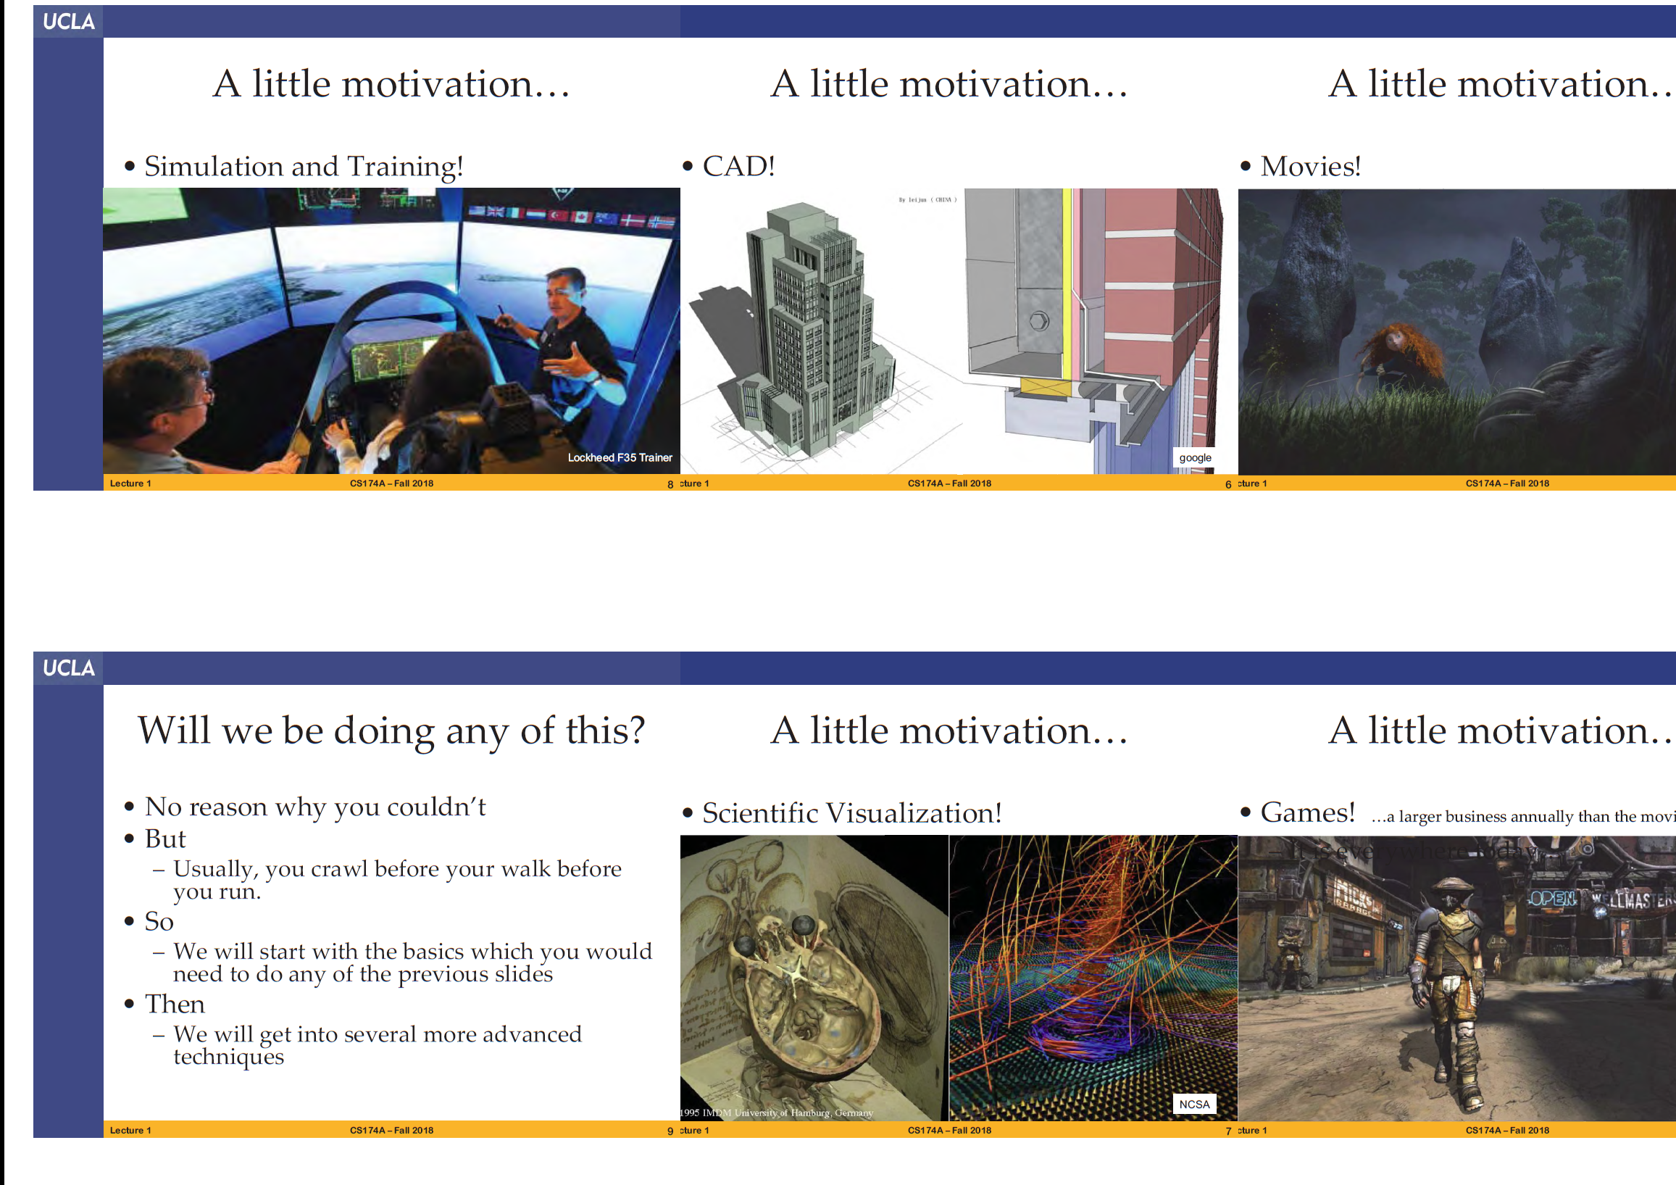
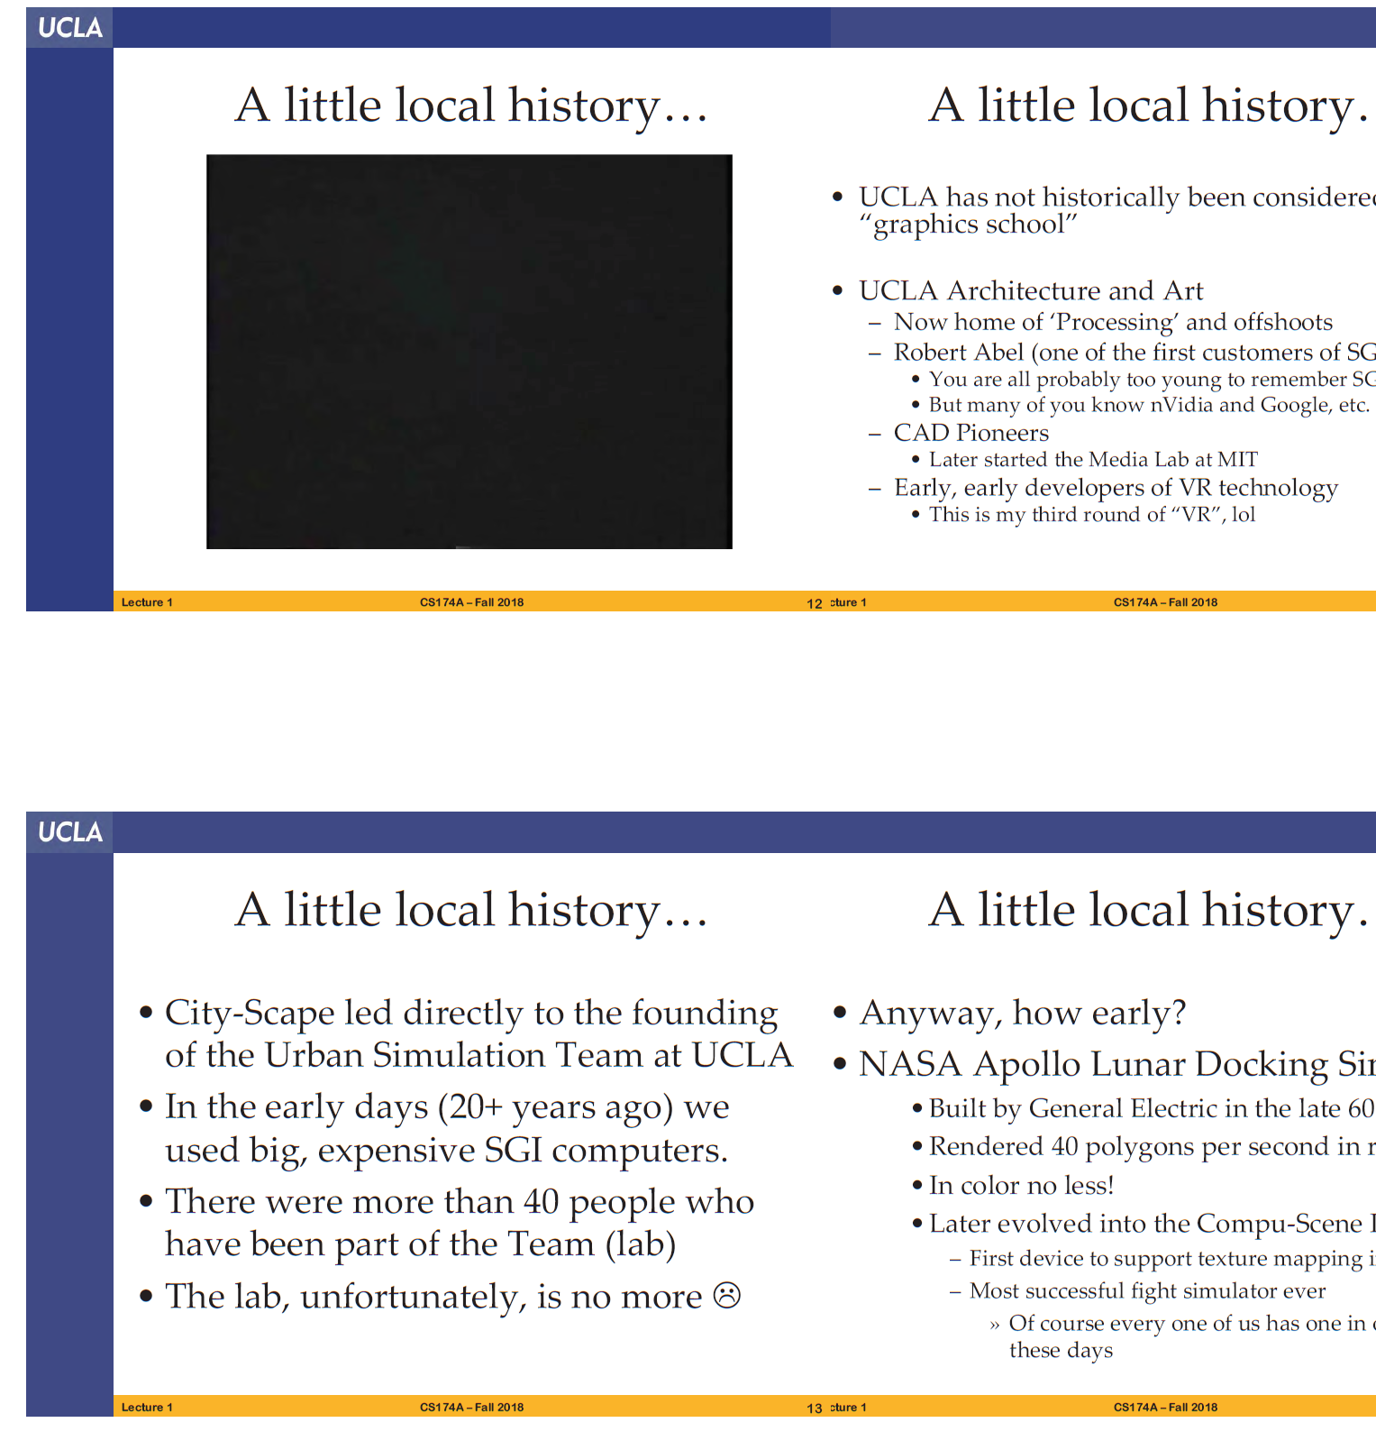
Motivation/local history

Slide 25
History
2000 B.C.
orthographic projection
1400s
Perspective: Italian Renaissance
1600s
coordinate systems: Descartes
optics: Huygens
optics, calculus, physics: Newton

Slide 26
History
1897 oscilloscope: Braun
1950-1970
computers with vector displays
1966
first true raster display
1993
1200x1200, 500k triangles/sec, 36-bit color, stereo, texture mapping… all at 60Hz
1995
feature-length CG films
Today…still rapidly evolving

Slide 27
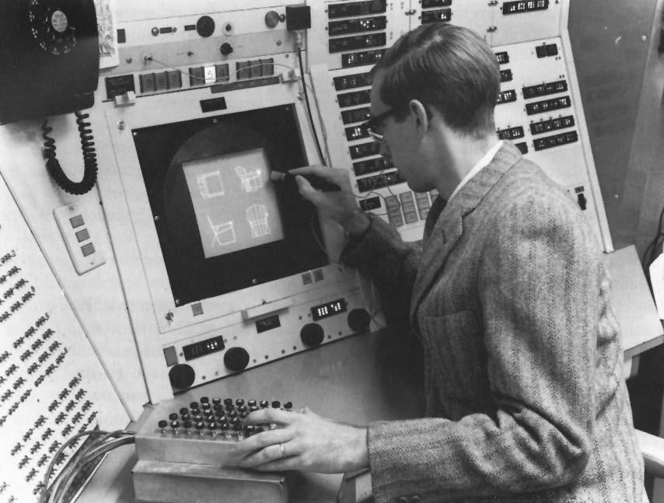
Genesis of Computer Graphics and Interactive Techniques
A PhD project at MIT in the early 1960s
Ivan E. Sutherland, 1963
“Sketchpad, a man-machine graphical communication system”

Slide 28
Trivia
https://design.osu.edu/carlson/history/timeline.html
When was the term “Computer Graphics” first stated?
William Fetter of Boeing coins the term "computer graphics" for his human factors cockpit drawings 1960
When was the Graphical User Interface developed?
GUI developed by Xerox (Alan Kay) 1969
When was Tron released?
Disney contracts Abel, III, MAGI and DE to create computer graphics for the movie Tron released in 1981

Slide 29
Trivia
Which is the first animated movie to employ CG?
“The Great Mouse Detective” (1986) was the first animated film to be aided by CG
When was the game “Doom” released?
1993
Which is the best selling game of all time?
http://en.wikipedia.org/wiki/List_of_best-selling_video_games Tetris (170M copies) Minecraft (154M copies) Grand Theft Auto V (100M copies) Wii Sports (83M copies) …

Slide 30
Trivia
Which is the newest CG animated movie?
Abominable
Which is bigger in terms of gross revenue, the game industry or the (Hollywood) movie industry?
The game industry
Which is your favorite animated movie?
Tangled, Moana, Frozen, Incredibles

Slide 31
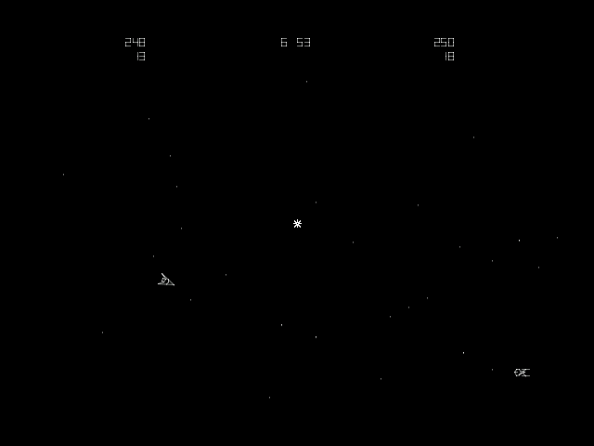
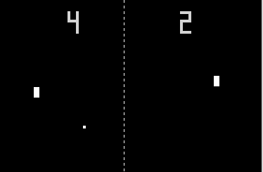
The First Computer Game?
Pong, Atari, 1972
Spacewars, PDP–1, MIT, 1961

Slide 32
The First “Computer” Game – 1958 !!
“Tennis for Two”

Slide 33
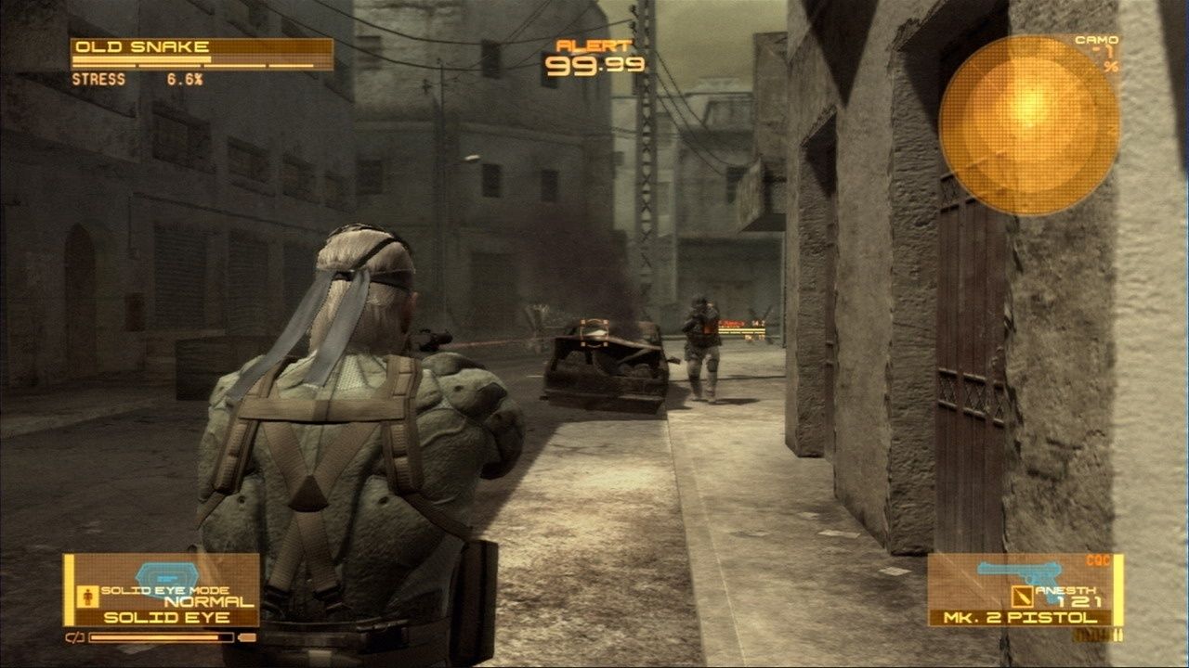

Metal Gear Solid 4

Slide 34
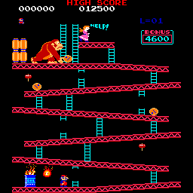

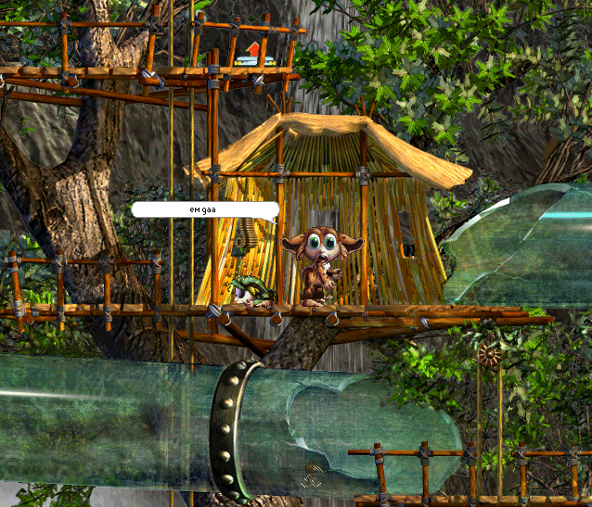
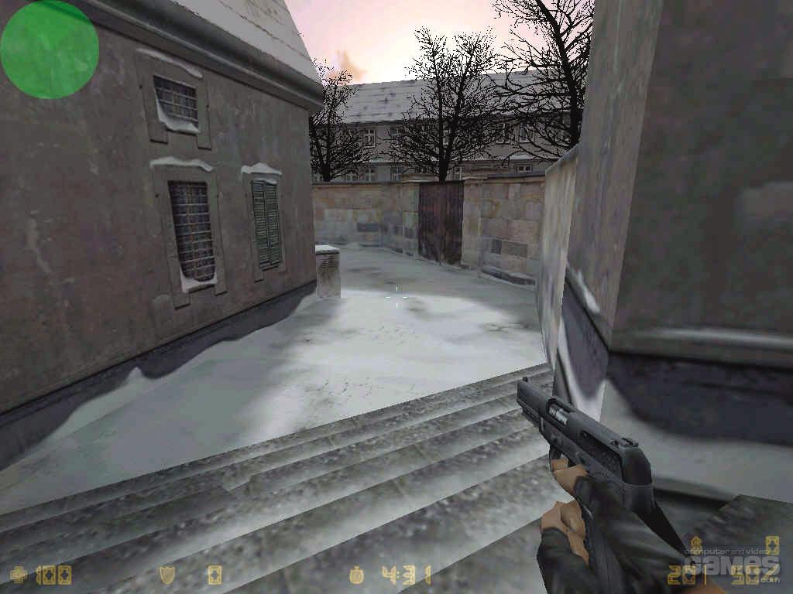
Games
Focus on interactivity

Slide 35
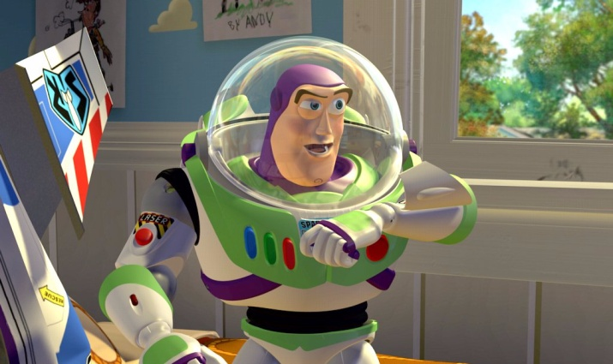
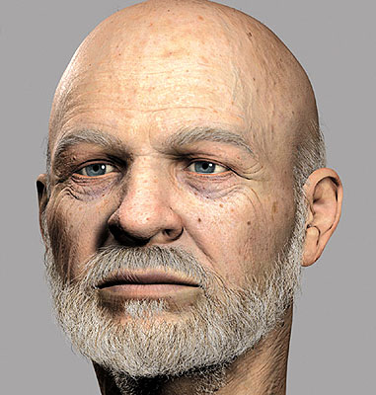
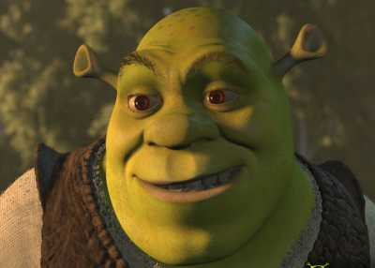
Movies
To reality and beyond !

Slide 36

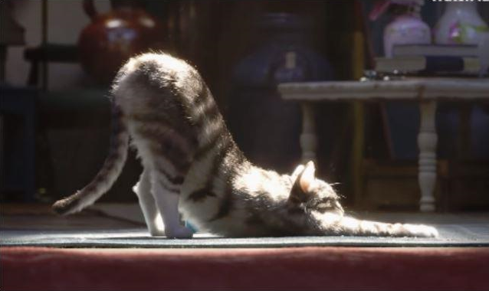
Movies
Toy Story 1 (1995) Toy Story 4 (2019)

Slide 37
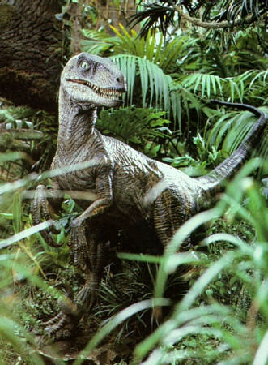
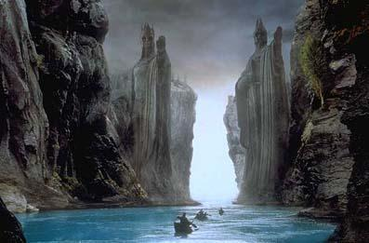
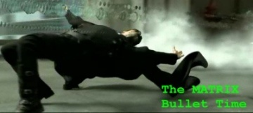
Movies
Special effects

Slide 38

Movies

Slide 39
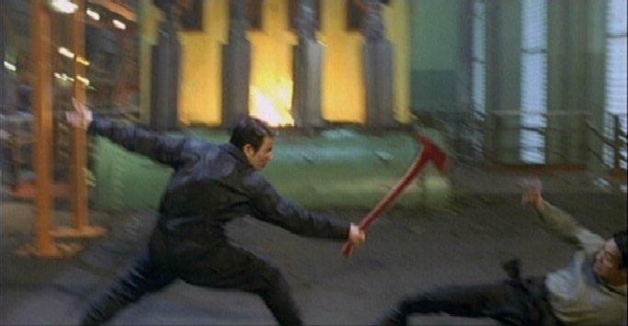
Digital Compositing

Slide 40
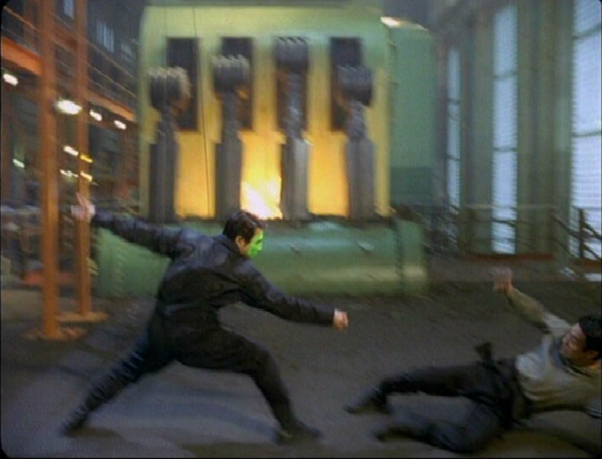
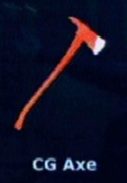
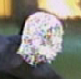
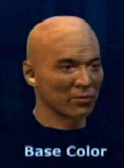
Digital compositing

Slide 41
Digital Compositing

Slide 42
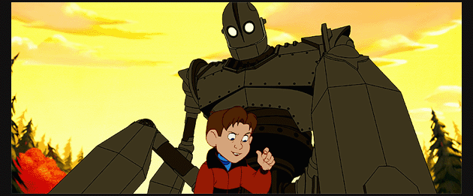
Cartoons

Slide 43
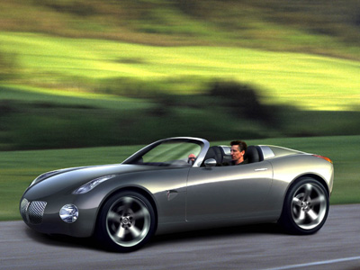
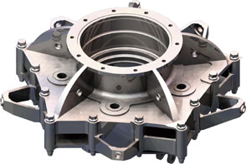
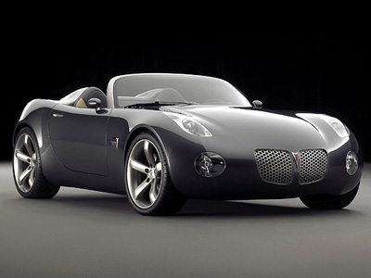
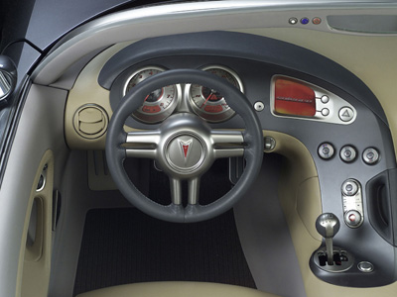
Computer-Aided Design
Precision modeling
Engineering visualization

Slide 44
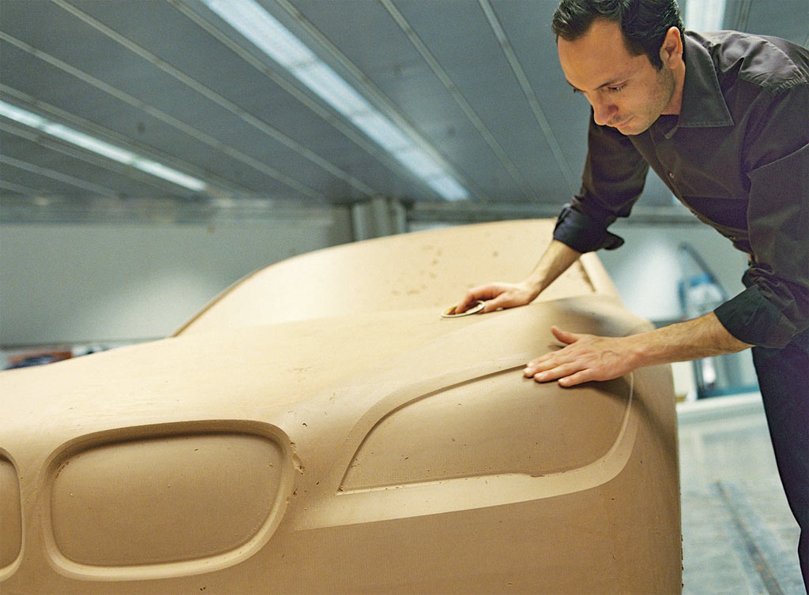
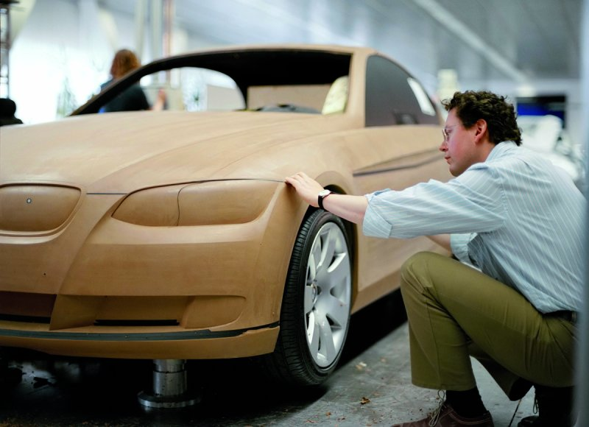
Modeling Clay

Slide 45

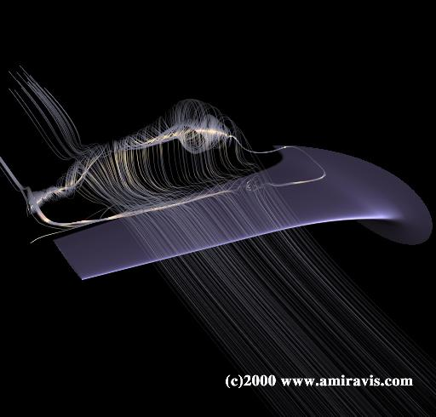
Computer-Aided Design
It’s not just about visualization
Simulation is also useful

Slide 46
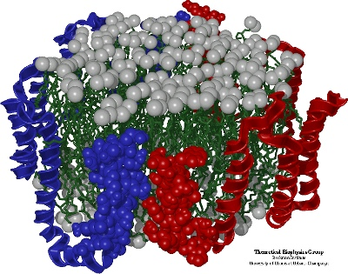
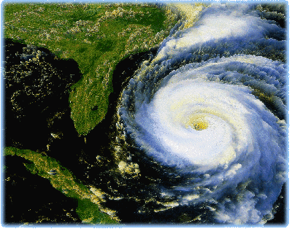
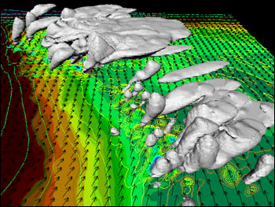
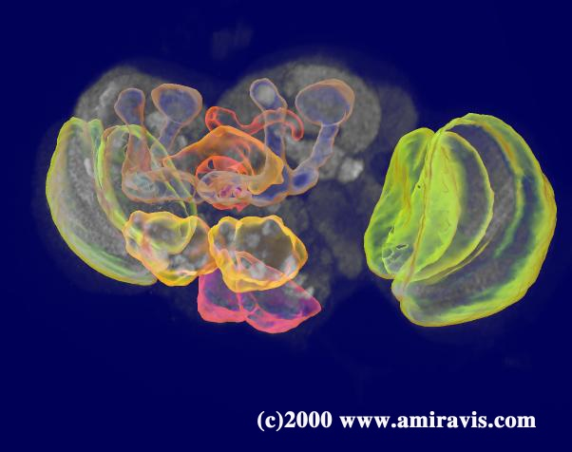
Visualization: Scientific
Molecular Biology
Environmental Physics

Slide 47

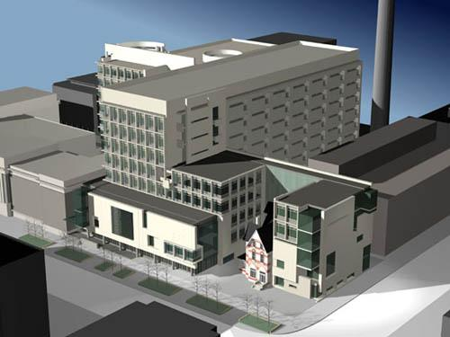
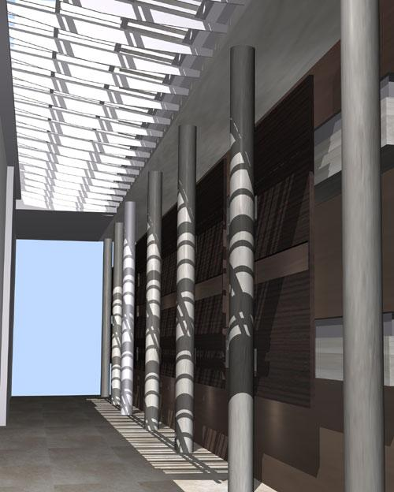
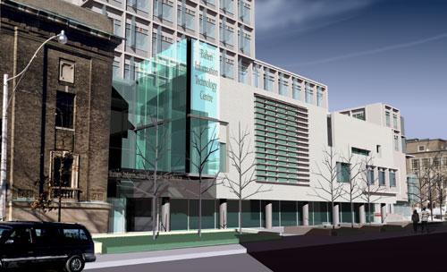
Visualization: Architectural
http://www.diamondschmitt.com/

Slide 48
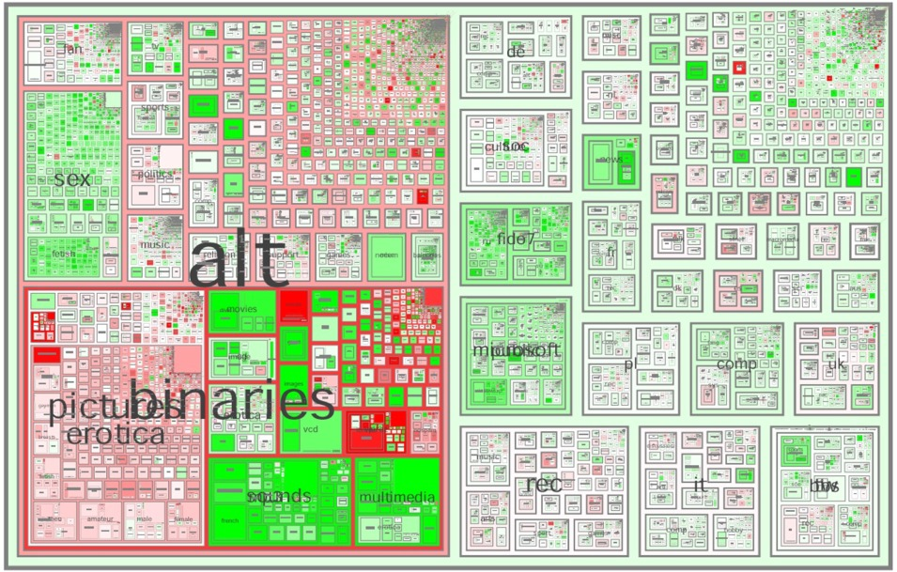
Visualization: Info
Smith and Fiore

Slide 49
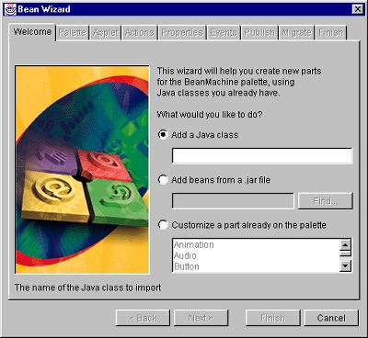
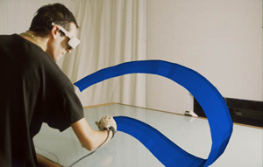
Graphical User Interfaces
Steven Schkolne
WIMP

Slide 50
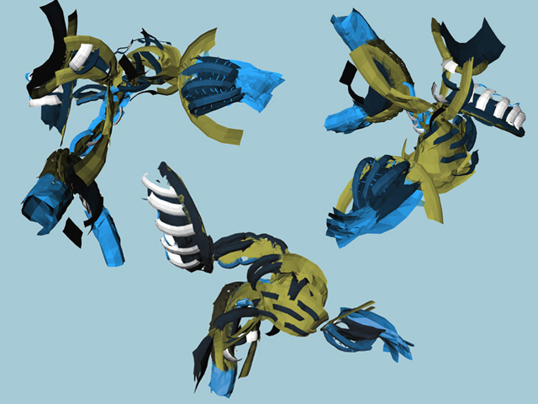
Art
Steven Schkolne

Slide 51
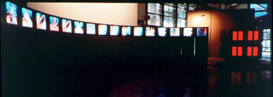
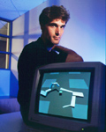
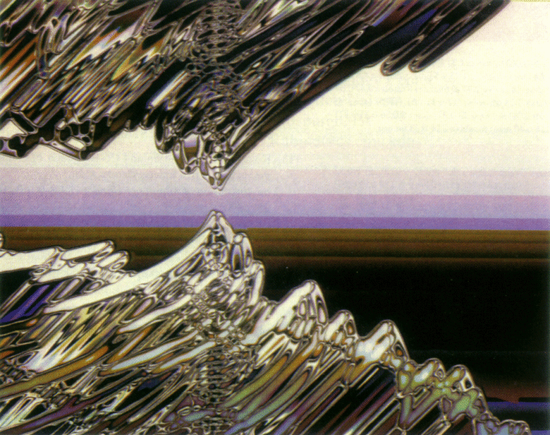
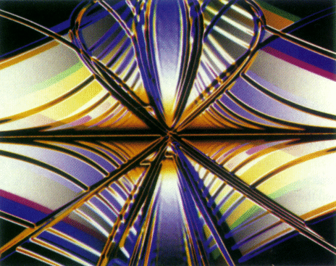
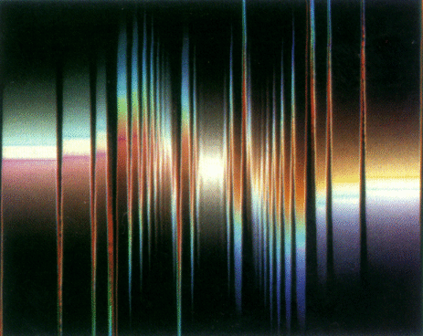
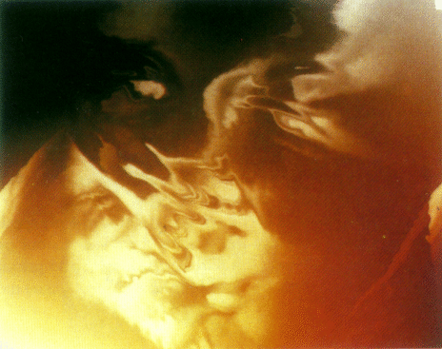


Digital Art
Genetically evolved
Carl Sims

Slide 52

Digital Art
By Jason Salavon
“Titanic”
The Top-Grossing Film of All Time
^
2nd

Slide 53

Basic Elements
Modeling
Animation
Rendering
Interaction

Slide 54
Basic Elements
Modeling
How do we model (mathematically represent) objects?
How do we construct models of specific objects?
Animation
How do we represent the motions of objects?
How do we give animators control of this motion?
Rendering
How do we simulate the real-world behavior of light?
How do we simulate the formation of images?
Interaction
How do we enable humans and computers to interact?
How do we design human-computer interfaces?

Slide 55

Modeling
Primitives
3D points
3D lines and curves
Surfaces (BREPs): polygons, patches
Volumetric representations
Image-based representations
Attributes
Color, texture maps
Lighting properties
Geometric transformations

Slide 56

Rendering
Visibility
Simulating light propagation
Reflection
Asborption
Scattering
Emission
Interference

Slide 57


Animation
Keyframe animation
Motion capture
Procedural animation
Physics-based animation
Behavioral animation
Emotion-based animation

Slide 58

Modeling
Representing objects geometrically on a computer
Point clouds
Texture maps
Polygon meshes
Surface patches NURBS
Parametric curves

Slide 59





Modeling
Voxels
Alternative representations
Blobs
Subdivision surfaces

Slide 60


Modeling
Altering geometric models
Affine transform
Ying, Kristjansson, Biermann, Zorin

Slide 61


Scanning Shapes
Digital Michaelangelo Project

Slide 62

Plant Modeling

Slide 63


Plant Modeling

Slide 64

Rendering
Illumination
Key elements
Camera
Geometric Shape
& Reflectance
Pixels

Slide 65


Camera Model

Slide 66



Rendering
Draw visible surfaces onto display
Camera (view direction)
Clipping
Scan Conversion
Image Plane
Camera (eye position)

Slide 67

Reflectance Modeling

Slide 68

Complex Reflectance

Slide 69

Subsurface Scattering
Translucency and varied levels of light penetration can be created using subsurface scattering effects

Slide 70

Texture
Multilevel texture synthesis

Slide 71



Non-Photorealistic Rendering
Aaron Hertzmann

Slide 72

Rendering: Information

Slide 73


Animation
Keyframe animation
Keyframing

Slide 74








Animation
Pixar: “Luxo Jr.” (1986)

Slide 75





Animation
Motion capture

Slide 76


Animating Golem in LOTR

Slide 77



Animation
The Animatrix – “Final Flight of the Osiris”

Slide 78

Animation
Example: “Geri’s Game” - Pixar

Slide 79

Cloth Simulation

Slide 80





Animation
Dynamics
Physics-based animation

Slide 81


Fluid Simulation
Modeling
Incompressibility
Viscocity
Navier-Stokes Equations
Level Sets

Slide 82


Smoke Simulation
Assumptions
No viscosity
Rendering
Photon maps
Multiple scattering

Slide 83


Animation
Behavioral animation
Ethology

Slide 84

Reality is *Very* Complex

Slide 85


Reality is *Very* Complex

Slide 86

Reality is *Very* Complex

Slide 87
Modeling Transformations
Assembly

Slide 88
Viewing
Orthographic Perspective

Slide 89
Clipping
Remove what is not visible

Slide 90
Visibility
Resolve occlusions (efficiently)

Slide 91

Illumination
Compute normals and color at vertices
Per vertex operations

Slide 92
Shading

Slide 93
Rasterization
Convert to colored pixels

Slide 94

Texture Mapping

Slide 95

Other Issues
Shadows
Participating media
Subsurface scattering
Motion blur
Camera models
Etc.

Slide 96

A Final Result

Slide 97
What is Academic about all this?
The full collection of techniques and “hacks” known to the industry? No
The history of the techniques? No
The skill of getting code working? No
Well-understood math concepts that separate graphics from other programming? That’s better
Tying into graphics research sometimes

Slide 98
TA Session This Week
Following topics are on TA Session agenda:
Walkthrough of Piazza and how the class intends to use it
Walkthrough of Github
Discuss first project assignment https://classroom.github.com/a/PiJBdlUg
Introduction to JavaScript and WebGL
Grading criteria for projects
Intro to linear algebra and matrices

